Slide 1

Predicting Volatility
Group 3
Lanli Feng
Xiwei Liu
Shiyi Liu
Viktor Aghajanyan
Shaoyu Cheng
Oct. 21, 2021

Slide 2
Outline
01
02
03
Introduction
Lanli Feng
04
05
Data Description
Xiwei Liu
Linear regression model
Shiyi Liu
GARCH model
Viktor Aghajanyan
Trading Strategy
Shaoyu Cheng

Slide 3
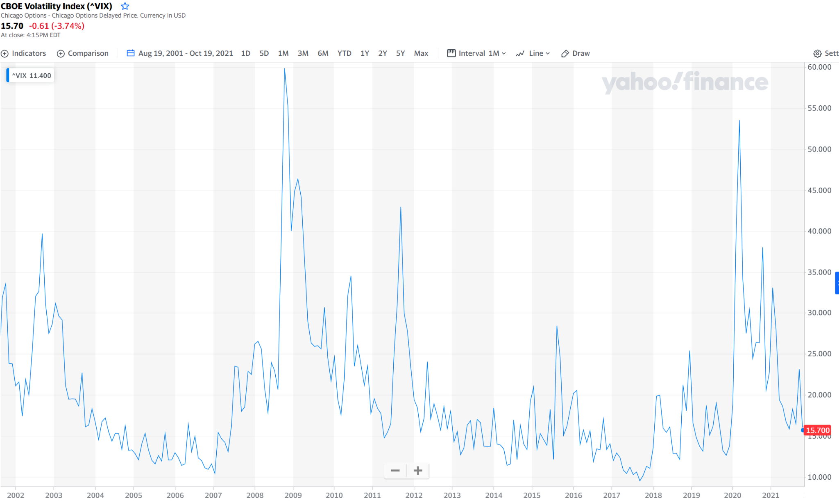
01 Introduction
VIX
Chicago Board Options Exchange’s (CBOE) volatility index
use S&P 500 option prices to determine expectations of the stock market 30-days-ahead volatility
gauge of the level of risk, fear, or stress in the market
Generalized Autoregressive Conditional Heteroskedasticity (GARCH)
discrete-time model for volatility
appropriate for time series data where the variance of the error term is serially autocorrelated
widely used to forecast VIX
Oct.2008
Mar. 2020
Source: Yahoo Finance

Slide 4
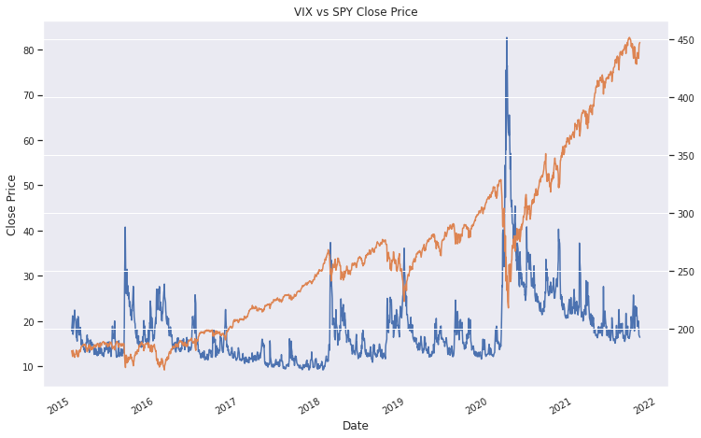
02 Data Description
Data Collection
Time Period: Jan 1, 2015 - now
Data: VIX, S&P 500, unemployment rate, CPI, PPI, oil price, federal required reserve rate, and a yield curve indicator
Source: Yahoo Finance and public information
VIX VS SPY Close Price
Data Information - VIX
Count | 1710
Mean | 17.757158
Std | 7.892246
Min | 9.14
Max | 82.690002
25% | 12.8325
50% | 15.6
75% | 20.557499
Blue Line: VIX Red Line: S&P 500

Slide 5
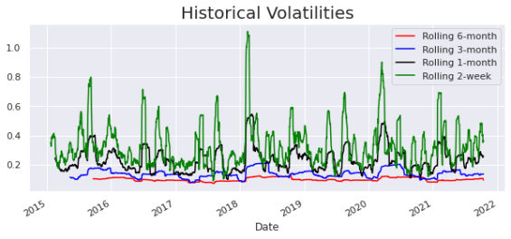
02 Data Description
Historical Volatilities of different rolling window length

Slide 6
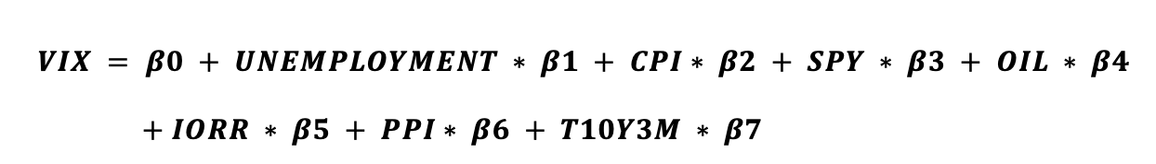
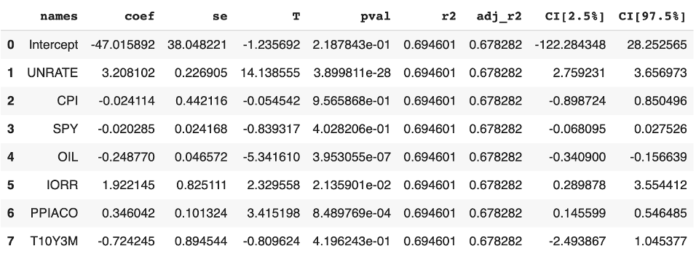
03 Regression Model
Stage One

Slide 7
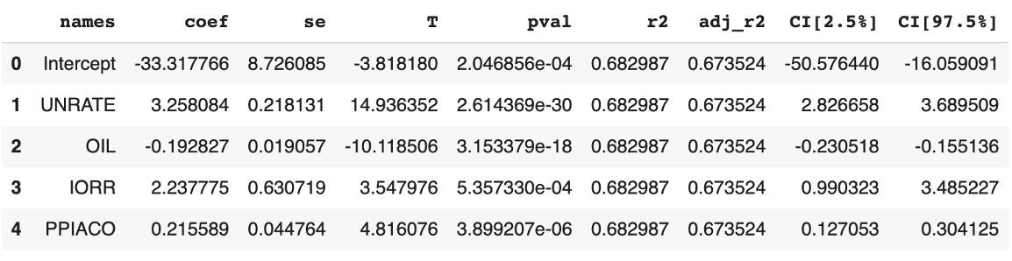
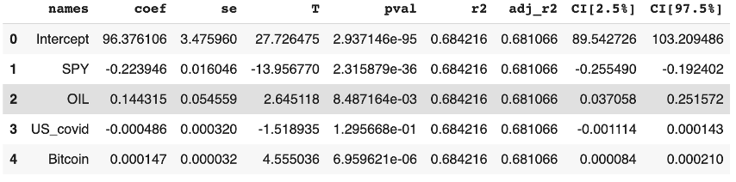
03 Regression Model
Stage Two
COVID&Bitcon

Slide 8
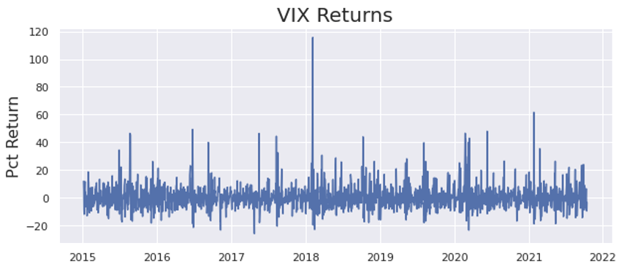
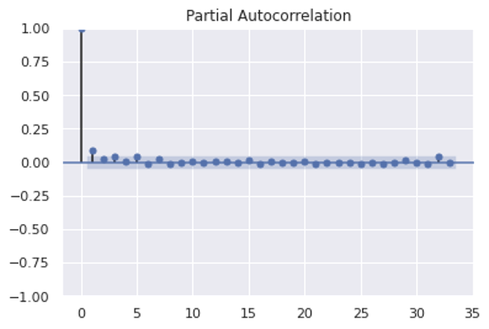
04 Model Selection: ARCH vs GARCH
VIX is a good candidate for the ARCH/GARCH process because there are periods of much higher volatility compared to general volatility in the chosen period.
We can see that in PACF it is pretty strong until 2 and then shuts off. This hinges us to choose GARCH (2,0) model.

Slide 9
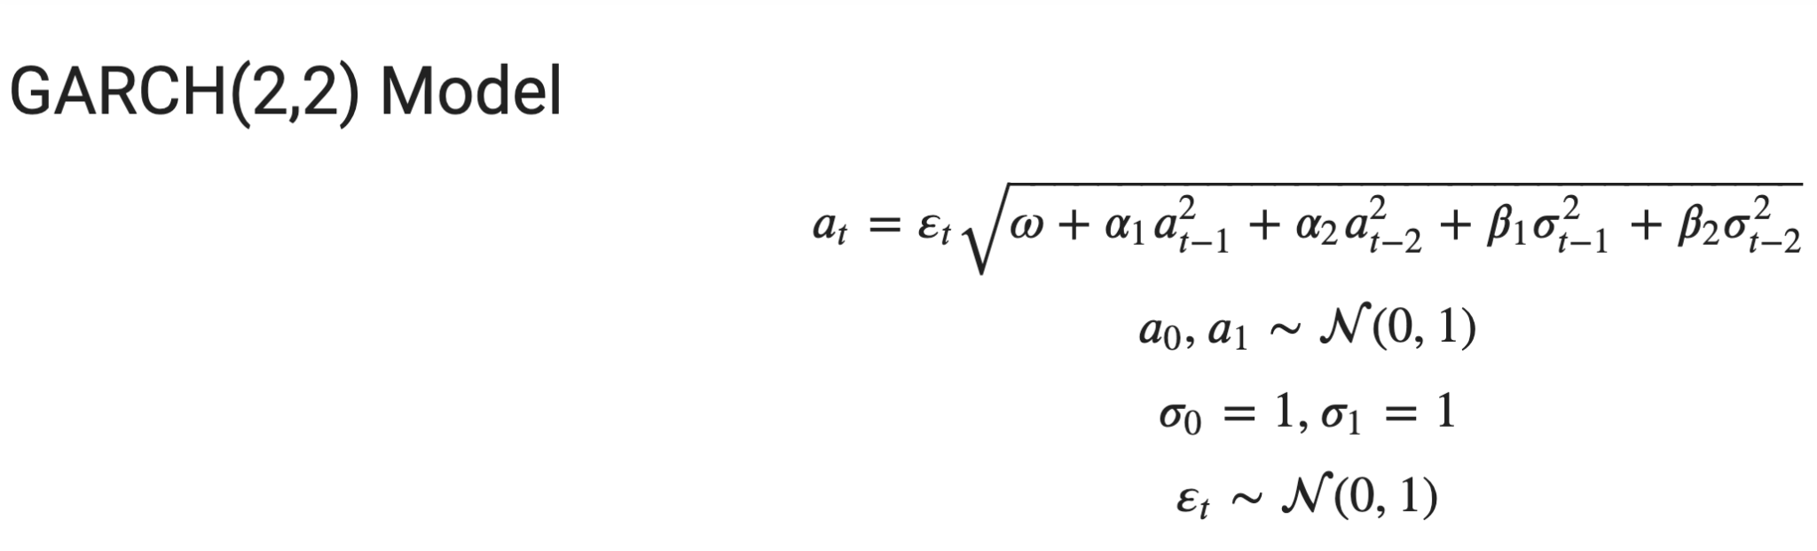
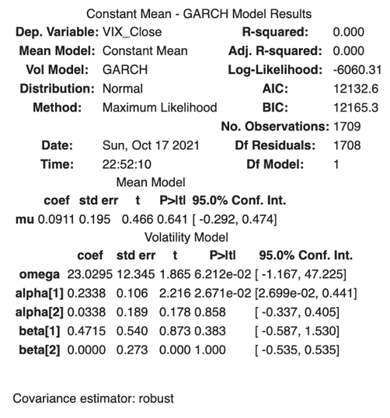
04 Model Selection: ARCH vs GARCH
To fit the actual GARCH model, we used ARCH python library with:
· model = arch_model(returns, p=2, q=2)
We can see that the choice of GARCH (2,2) model was wrong given that alpha [2], beta [1], and beta [2] all have p values larger than 0.05. Next, we dropped the complexity of the model from GARCH (2,2) to just ARCH (2,0).

Slide 10
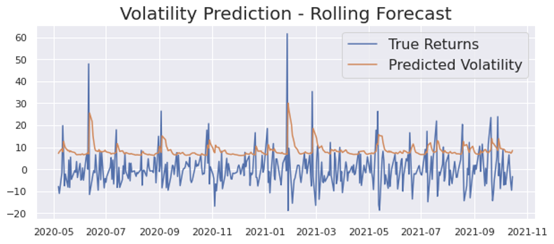
04 Model Selection: ARCH vs GARCH GARCH 2-0 Model
Our ARCH model has done a pretty good job in predicting the spikes in VIX over the 2020 as can be evidenced later in the profitable trading strategy that we designed.

Slide 11
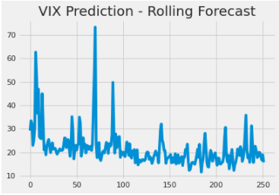
05 Investment Strategy
Predicting VIX
ARCH model
- trend of price changes
predicted daily returns
historical VIX
VIX predictions

Slide 12
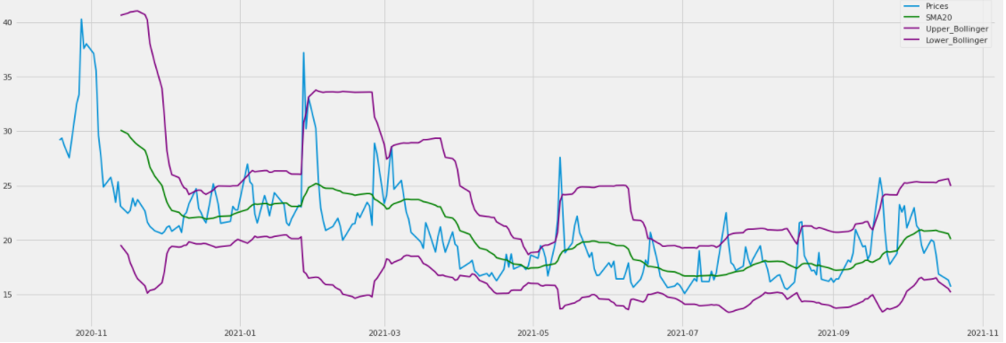
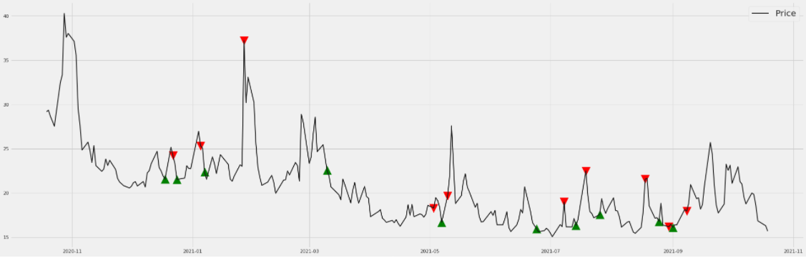
05 Investment Strategy
Bollinger Band
Bollinger Band: MA20±2*σ
mean-converging
put
put position:
> upper Band
last order:long
long

Slide 13
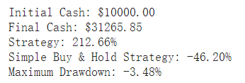
05 Investment Strategy
Predicting VIX
https://colab.research.google.com/drive/11XpTl4wWikqVHWsHZHIA_8KiSv02-x2B#scrollTo=qYzNOjB3f8qI

Slide 14
References
Kuepper, J. (2021, October 14). Cboe volatility index (VIX). Investopedia. Retrieved October 17, 2021, from https://www.investopedia.com/terms/v/vix.asp.
The Investopedia Team. (2021, June 11) GARCH. Investopedia. Retrieved from https://www.investopedia.com/terms/g/garch.asp
The VIX: My biggest moneymaker in 20 years of trading. The Profit Takeover. (2021, June 15). Retrieved October 17, 2021, from https://theprofittakeover.com/the-vix-my-big gest-moneymaker-in-20-years-of-trading/
Hao J., Zhang J.E. (2013) GARCH option pricing models, the CBOE VIX and variance risk premium. Journal of Financial Econometircs, 11, pp. 556-580
Majmudar, U., & Banerjee, A. (2004, April 21). Vix forecasting. SSRN. Retrieved from https://papers.ssrn.com/sol3/papers.cfm?abstract_id=533583.
Liu Q., Guo S., Qiao G., (2015) VIX forecasting and variance risk premium: A new GARCH approach. North American Journal of Economics and Finance, 34, pp. 314-322
Saha, A., Malkiel, B.G. & Rinaudo, A. (2019) Has the VIX index been manipulated?. J Asset Manag 20, 1–14 (2019). https://doi.org/10.1057/s41260-018-00102-4
FRED. (2021) Unemployment Rate [Data file]. Retrieved from https://fred.stlouisfed.org/series/UNRATE
FRED. (2021) CPI [Data file]. Retrieved from https://fred.stlouisfed.org/series/CPIAUCSL
U.S. Bureau of Labor Statistics. (2021) PPI [Data file]. Retrieved from https://www.bls.gov/ppi/#data
FRED. (2021) 10-Year Treasury Constant Maturity Minus 3-Month Treasury Constant Maturity (T10Y3M) [Data file]. Retrieved from https://fred.stlouisfed.org/series/T10Y3M
FRED. (2021) IORR Interest Rate Spread [Data file]. Retrieved from https://fred.stlouisfed.org/series/IORR
Github. (2021) COVID death data[Data file].
Yahoo Finance.(2021) Bitcoin Closing Price [Data file]. Retrieved from https://finance.yahoo.com/quote/BTC-USD/
Yahoo Finance.(2021) Crude Oil prices [Data file]. Retrieved from https://finance.yahoo.com/quote/CL=F/
Yahoo Finance.(2021) S&P Close [Data file]. Retrieved from https://finance.yahoo.com/quote/%5EGSPC?p=%5EGSPC

Slide 15

Q&A

